Slide 1

BDNS ET PROJECT using SPARK ML
Arghya Roy Chowdhury
– A23007

Slide 2
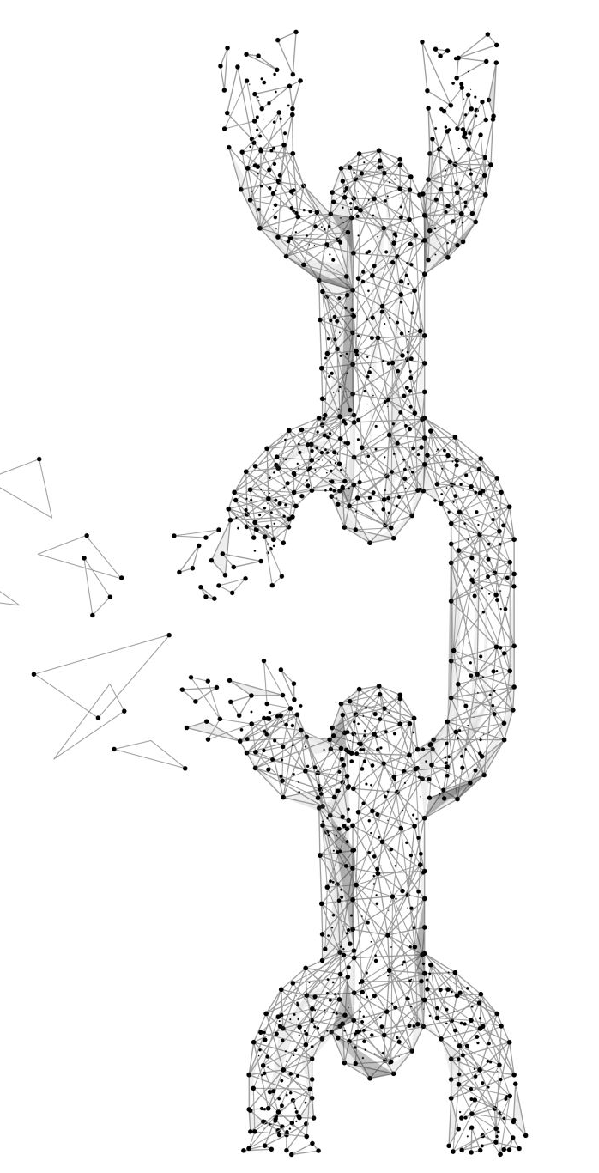
IMPORTANT LINKS
Colab Link
Link to Dataset

Slide 3

OBJECTIVE
The Objective of the project is to predict resale value of used cars using spark and machine learning models, so that it is useful for both business owners and customers.

Slide 4
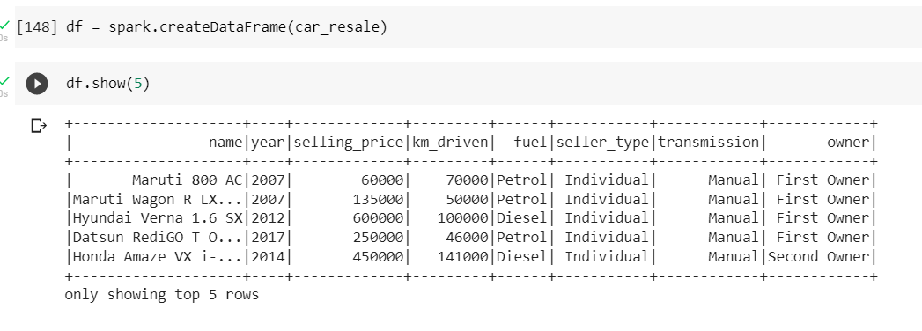
About the dataset
The dataset is downloaded from Kaggle, it has 4340 records. Selling_price is the target variable for us in the dataset. There were no null values in the dataset. There are 8 columns in the dataset. A snapshot the dataset is attached.

Slide 5
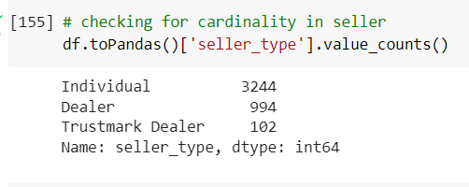
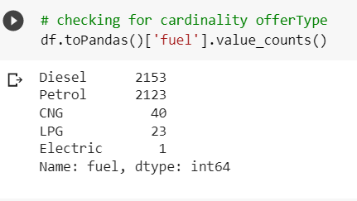
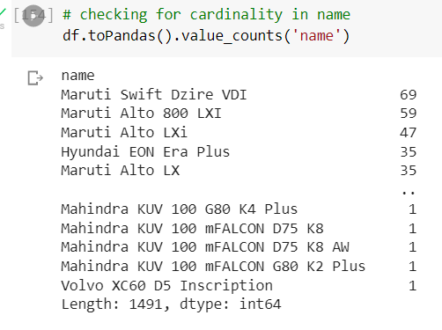
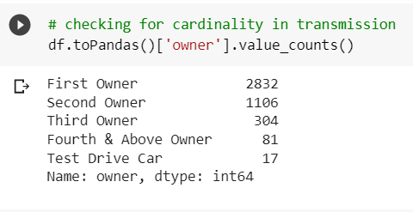
Cardinality of the categorical variables

Slide 6
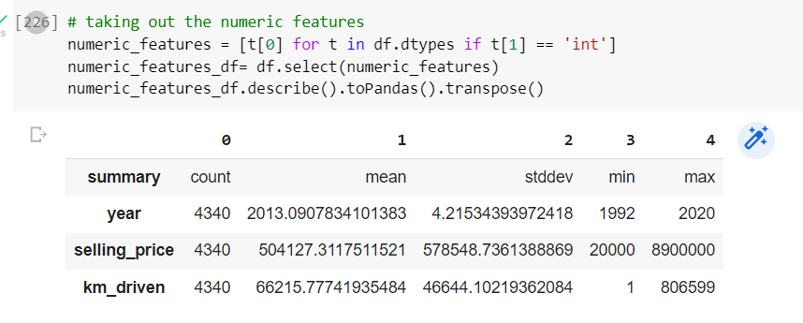
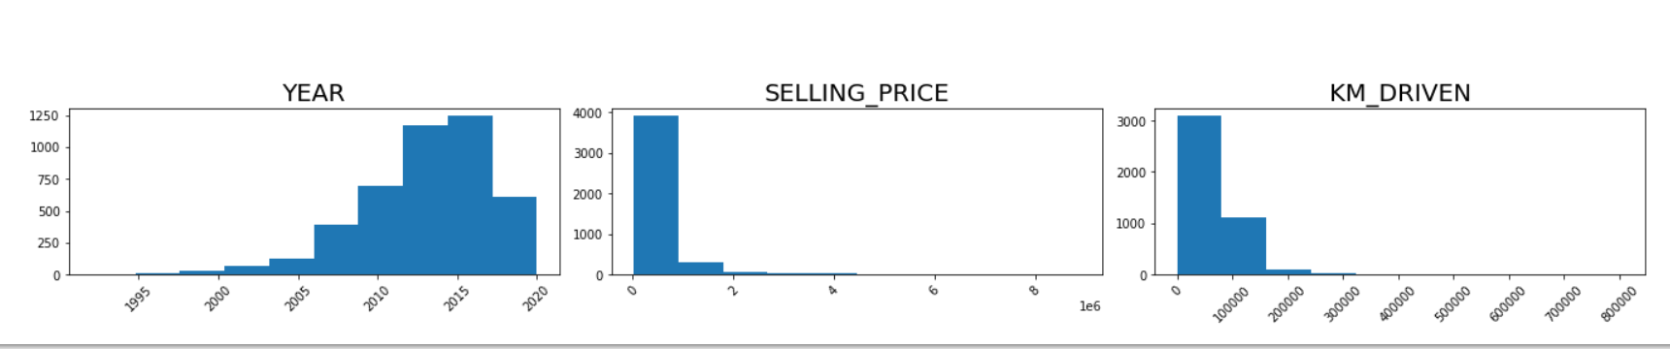
Continuous variables

Slide 7
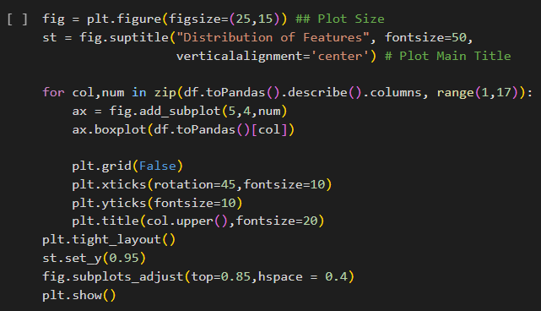
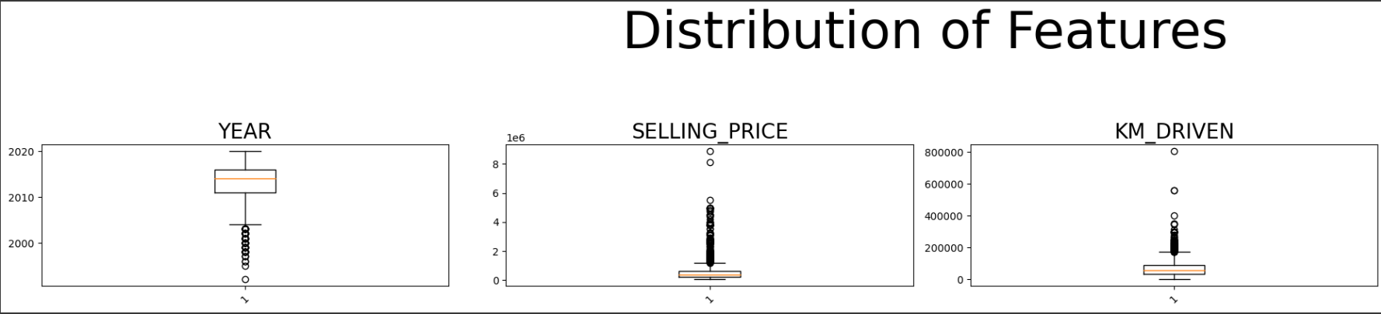
distribution of the Continuous Variables

Slide 8
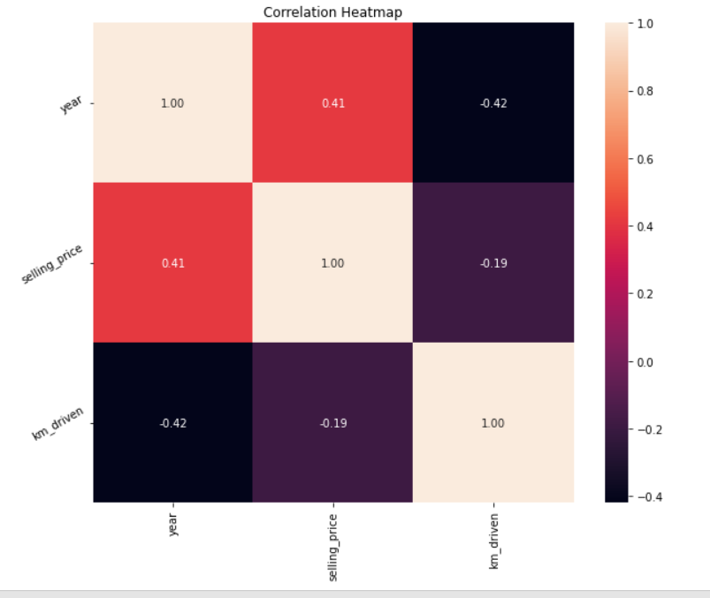
Checking for Multicollinearity
From the correlation heatmap we can see that the linear association/ correlation between our variables is not more than 0.5 in all the cases which can be considered as weak correlation. So we can conclude that there are minimal chances of multicollinearity in our dataset.

Slide 9
Data pre-processing
For data pre-processing, we have used the following tools :
String Indexer
One Hot encoder
Assembler
Standard Scaler

Slide 10
Basic pipeline
This pipeline prepares data for predicting car prices by converting categorical information (like car name, fuel type, etc.) into a format suitable for machine learning, ensuring accurate and efficient model training.

Slide 11
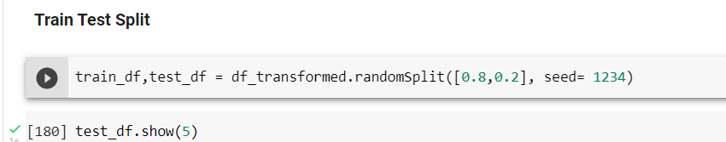
Train Test Split
Our dataset is split into training and testing in the ratio of 80 percent, 20 percent, respectively.

Slide 12
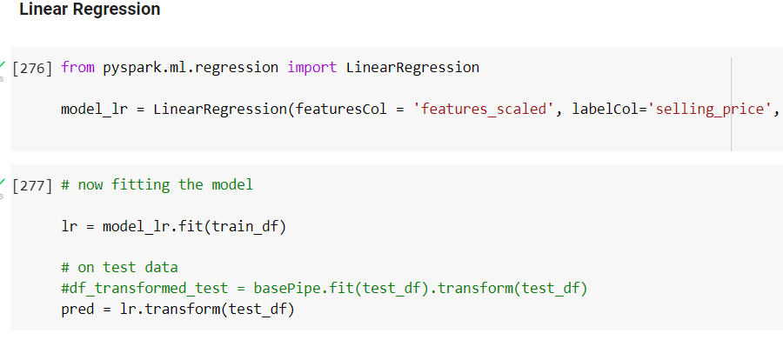
Linear Regression
Using a Linear regression model we got the following values of our evaluation metrics
RMSE – 444778.43
R-SQUARED – 0.60

Slide 13
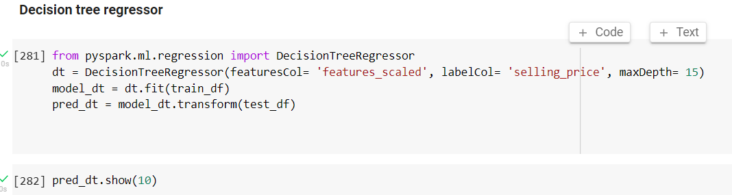
Decision Tree Regressor
Using a Decision Tree Regressor we got the following values of our evaluation metrics
RMSE – 455618.41
R-SQUARED – 0.59

Slide 14
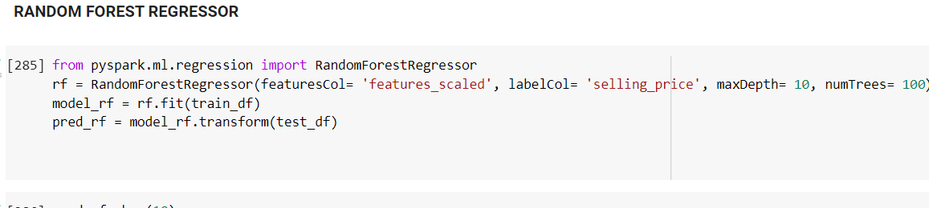
Random Forest Regressor
Using a Random Forest Regressor, we got the following values of our evaluation metrics
RMSE – 450742.19
R-SQUARED – 0.59

Slide 15
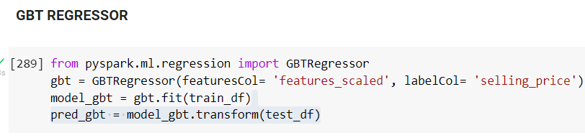
Gradient Boost Tree Regressor
Using a GBT Regressor we got the following values of our evaluation metrics
RMSE – 465455.54
R-SQUARED – 0.57

Slide 16
CONCLUSION
Linear Regression is giving the best result in our case when compared with other models with respect to RMSE and R-SQUARED.
MODELS | RMSE | R-SQUARED
Linear Regression | 444778.43 | 0.60
Decision Tree | 455618.41 | 0.59
Random Forest | 450742.19 | 0.59
Gradient Boost | 465455.54 | 0.57

Slide 17
The business perspective of the project.
From a business point of view the help that the business gets from this project is, it can now have an idea how much a car can be sold for, at least with 60 percent accuracy.
If a customer comes in asking for a car price, immediately, this accurate model can help the business owner pitch a near approximate price for the car, within no time, as we have used PySpark to build this model and it works faster.

Slide 18
Thank you

